Slide 1
Bits, Bytes, and Integers
Representing information as bits
Bit-level manipulations
Integers
  Representation: unsigned and signed
  Conversion, casting
  Expanding, truncating
  Addition, negation, multiplication, shifting
Summary

Slide 2
Encoding Byte Values
Decimal
Hex
Binary
Byte = 8 bits
  Binary 000000002 to 111111112
  Decimal: 010 to 25510
  Hexadecimal 0016 to FF16
    Base 16 number representation
    Use characters ‘0’ to ‘9’ and ‘A’ to ‘F’
    Write FA1D37B16 in C as
      0xFA1D37B
      0xfa1d37b
0
0
0000
1
1
0001
2
2
0010
3
3
0011
4
4
0100
5
5
0101
6
6
0110
7
7
0111
8
8
1000
9
9
1001
A
10
1010
B
11
1011
C
12
1100
D
13
1101
E
14
1110
F
15
1111

Slide 3
Byte-Oriented Memory Organization
00•••0
FF•••F
• • •
Programs Refer to Virtual Addresses
  Conceptually very large array of bytes
  Actually implemented with hierarchy of different memory types
  System provides address space private to particular “process”
    Program being executed
    Program can clobber its own data, but not that of others
Compiler + Run-Time System Control Allocation
  Where different program objects should be stored
  All allocation within single virtual address space

Slide 4
Machine Words
Machine Has “Word Size”
  Nominal size of integer-valued data
    Including addresses
  Low-end machines use 32 bits (4 bytes) words
    Limits addresses to 4GB
    Becoming too small for memory-intensive applications
  High-end systems use 64 bits (8 bytes) words
    Potential address space ≈ 1.8 X 1019 bytes
    x86-64 machines support 48-bit addresses: 256 Terabytes
  Machines support multiple data formats
    Fractions or multiples of word size
    Always integral number of bytes

Slide 5
Word-Oriented Memory Organization
32-bit
Words
64-bit
Words
Bytes
Addr.
Addresses Specify Byte Locations
  Address of first byte in word
  Addresses of successive words differ by 4 (32-bit) or 8 (64-bit)
0000
Addr
=
??
0001
0000
0002
Addr
=
??
0003
0000
0004
Addr
=
??
0005
0004
0006
0007
0008
Addr
=
??
0009
0008
0010
Addr
=
??
0011
0008
0012
Addr
=
??
0013
0012
0014
0015

Slide 6
Data Representations
C Data Type | Typical 32-bit | Intel IA32 | x86-64
char | 1 | 1 | 1
short | 2 | 2 | 2
int | 4 | 4 | 4
long | 4 | 4 | 8
long long | 8 | 8 | 8
float | 4 | 4 | 4
double | 8 | 8 | 8
long double | 8 | 10/12 | 10/16
pointer | 4 | 4 | 8

Slide 7
Bits, Bytes, and Integers
Representing information as bits
Bit-level manipulations
Integers
  Representation: unsigned and signed
  Conversion, casting
  Expanding, truncating
  Addition, negation, multiplication, shifting
Summary

Slide 8
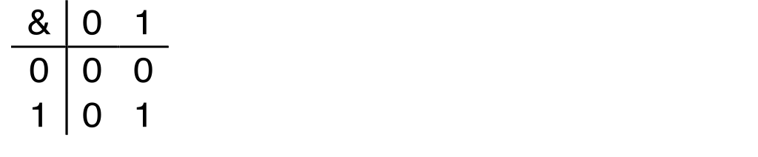
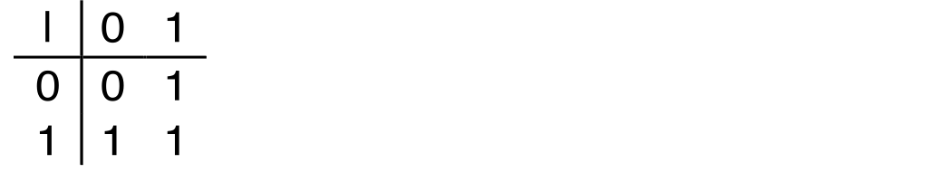
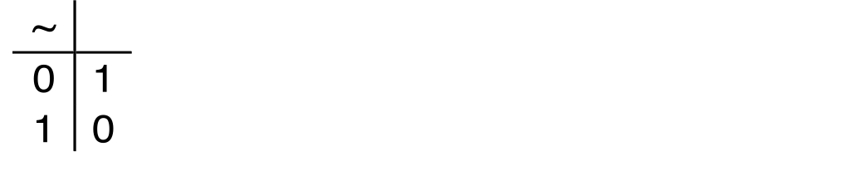
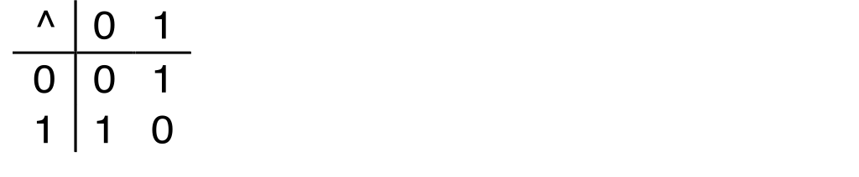
Boolean Algebra
Developed by George Boole in 19th Century
  Algebraic representation of logic
    Encode “True” as 1 and “False” as 0
And
A&B = 1 when both A=1 and B=1
Or
A&B = 1 when both A=1 and B=1
Not
~A = 1 when A=0
Exclusive-Or (Xor)
A^B = 1 when either A=1 or B=1, but not both

Slide 9
General Boolean Algebras
Operate on Bit Vectors
  Operations applied bitwise
All of the Properties of Boolean Algebra Apply
01101001
& 01010101
01000001
01101001
| 01010101
01111101
01101001
^ 01010101
00111100
~ 01010101
10101010
01000001
01111101
00111100
10101010

Slide 10
Bit-Level Operations in C
Operations &, |, ~, ^ Available in C
  Apply to any “integral” data type
    long, int, short, char, unsigned
  View arguments as bit vectors
  Arguments applied bit-wise
Examples (Char data type)
  ~0x41 ➙ 0xBE
    ~010000012 ➙ 101111102
  ~0x00 ➙ 0xFF
    ~000000002 ➙ 111111112
  0x69 & 0x55 ➙ 0x41
    011010012 & 010101012 ➙ 010000012
  0x69 | 0x55 ➙ 0x7D
    011010012 | 010101012 ➙ 011111012

Slide 11
Contrast: Logic Operations in C
Contrast to Logical Operators
  &&, ||, !
    View 0 as “False”
    Anything nonzero as “True”
    Always return 0 or 1
    Early termination
Examples (char data type)
  !0x41 ➙ 0x00
  !0x00 ➙ 0x01
  !!0x41 ➙ 0x01
  0x69 && 0x55 ➙ 0x01
  0x69 || 0x55 ➙ 0x01

Slide 12
Shift Operations
Left Shift: x << y
  Shift bit-vector x left y positions
      Throw away extra bits on left
    Fill with 0’s on right
Right Shift: x >> y
  Shift bit-vector x right y positions
    Throw away extra bits on right
  Logical shift
    Fill with 0’s on left
  Arithmetic shift
    Replicate most significant bit on right
Undefined Behavior
  Shift amount < 0 or ≥ word size
Argument x
01100010
<< 3
00010000
00010000
00010000
Log. >> 2
00011000
00011000
00011000
Arith. >> 2
00011000
00011000
00011000
Argument x
10100010
<< 3
00010000
00010000
00010000
Log. >> 2
00101000
00101000
00101000
Arith. >> 2
11101000
11101000
11101000

Slide 13
Bits, Bytes, and Integers
Representing information as bits
Bit-level manipulations
Integers
  Representation: unsigned and signed
  Conversion, casting
  Expanding, truncating
  Addition, negation, multiplication, shifting
Summary

Slide 14
Encoding Integers
Unsigned
Two’s Complement
short int x = 15213;
short int y = -15213;
Sign
Bit
C short 2 bytes long
Sign Bit
  For 2’s complement, most significant bit indicates sign
    0 for nonnegative
    1 for negative

Slide 15
Encoding Example (Cont.)
x = 15213: 00111011 01101101
y = -15213: 11000100 10010011

Slide 16
Numeric Ranges
Unsigned Values
  UMin = 0
000…0
  UMax = 2w – 1
111…1
Two’s Complement Values
  TMin = –2w–1
100…0
  TMax = 2w–1 – 1
011…1
Other Values
  Minus 1
111…1
Values for W = 16

Slide 17
Values for Different Word Sizes
Observations
  |TMin | = TMax + 1
    Asymmetric range
  UMax = 2 * TMax + 1
C Programming
  #include <limits.h>
  Declares constants, e.g.,
    ULONG_MAX
    LONG_MAX
    LONG_MIN
  Values platform specific

Slide 18
Today: Bits, Bytes, and Integers
Representing information as bits
Bit-level manipulations
Integers
  Representation: unsigned and signed
  Conversion, casting
  Expanding, truncating
  Addition, negation, multiplication, shifting
Summary

Slide 19
Casting Surprises
Expression Evaluation
  If there is a mix of unsigned and signed in single expression,
  signed values implicitly cast to unsigned
  Including comparison operations <, >, ==, <=, >=
  Examples for W = 32: TMIN = -2,147,483,648 , TMAX = 2,147,483,647
Constant1 Constant2 Relation Evaluation
0 0U
-1 0
-1 0U
2147483647 -2147483647-1
2147483647U -2147483647-1
-1 -2
(unsigned)-1 -2
2147483647 2147483648U
2147483647 (int) 2147483648U
0 0U == unsigned
-1 0 < signed
-1 0U > unsigned
2147483647 -2147483648 > signed
2147483647U -2147483648 < unsigned
-1 -2 > signed
(unsigned) -1 -2 > unsigned
2147483647 2147483648U < unsigned
2147483647 (int) 2147483648U > signed

Slide 20
Bits, Bytes, and Integers
Representing information as bits
Bit-level manipulations
Integers
  Representation: unsigned and signed
  Conversion, casting
  Expanding, truncating
  Addition, negation, multiplication, shifting
Summary

Slide 21
Sign Extension
Task:
  Given w-bit signed integer x
  Convert it to w+k-bit integer with same value
Rule:
  Make k copies of sign bit:
  X ′ = xw–1 ,…, xw–1 , xw–1 , xw–2 ,…, x0
k copies of MSB
w
X
• • •
• • •
X ′
• • •
• • •
k
w

Slide 22
Sign Extension Example
short int x = 15213;
int ix = (int) x;
short int y = -15213;
int iy = (int) y;
Decimal
Hex
Binary
x
15213
3B 6D
00111011 01101101
ix
15213
00 00 3B 6D
00000000 00000000 00111011 01101101
y
-15213
C4 93
11000100 10010011
iy
-15213
FF FF C4 93
11111111 11111111 11000100 10010011
Converting from smaller to larger integer data type
C automatically performs sign extension

Slide 23
Expanding, Truncating: Basic Rules
Expanding (e.g., short int to int)
  Unsigned: zeros added
  Signed: sign extension
  Both yield expected result
Truncating (e.g., unsigned to unsigned short)
  Unsigned/signed: bits are truncated
  Result reinterpreted
  Unsigned: mod operation
  Signed: similar to mod
  For small numbers yields expected behavior

Slide 24
Bits, Bytes, and Integers
Representing information as bits
Bit-level manipulations
Integers
  Representation: unsigned and signed
  Conversion, casting
  Expanding, truncating
  Addition, negation, multiplication, shifting
Summary

Slide 25
Unsigned Addition
u
Operands: w bits
• • •
+
v
• • •
True Sum: w+1 bits
u + v
• • •
Discard Carry: w bits
UAddw(u , v)
• • •

Slide 26
Visualizing (Mathematical) Integer Addition
Integer Addition
  4-bit integers u, v
  Compute true sum Add4(u , v)
  Values increase linearly with u and v
  Forms planar surface
Add4(u , v)
v
u

Slide 27
Visualizing Unsigned Addition
Wraps Around
  If true sum ≥ 2w
  At most once
Overflow
UAdd4(u , v)
True Sum
2w+1
Overflow
2w
v
0
Modular Sum
u

Slide 28
Two’s Complement Addition
Operands: w bits
u
• • •
+
v
• • •
True Sum: w+1 bits
u + v
• • •
Discard Carry: w bits
TAddw(u , v)
• • •

Slide 29
Visualizing 2’s Complement Addition
NegOver
Values
  4-bit two’s comp.
  Range from -8 to +7
Wraps Around
  If sum ≥ 2w–1
    Becomes negative
    At most once
  If sum < –2w–1
    Becomes positive
    At most once
TAdd4(u , v)
v
u
PosOver

Slide 30
Negation: Complement & Increment
Claim: Following Holds for 2’s Complement
~x + 1 == -x
Complement
  Observation: ~x + x == 1111…111 == -1
x
1
0
0
1
1
1
0
1
+
~x
0
1
1
0
0
0
1
0
-1
1
1
1
1
1
1
1
1

Slide 31
Unsigned Multiplication in C
u
• • •
Operands: w bits
*
v
• • •
True Product: 2*w bits
u · v
• • •
• • •
UMultw(u , v)
Discard w bits: w bits
• • •
Standard Multiplication Function
  Ignores high order w bits
Implements Modular Arithmetic
UMultw(u , v) = u · v mod 2w

Slide 32
Signed Multiplication in C
u
• • •
Operands: w bits
*
v
• • •
True Product: 2*w bits
u · v
• • •
• • •
TMultw(u , v)
Discard w bits: w bits
• • •
Standard Multiplication Function
  Ignores high order w bits

Slide 33
Power-of-2 Multiply with Shift
Operation
  u << k gives u * 2k
  Both signed and unsigned
Examples
  u << 3 == u * 8
  u << 5 - u << 3 == u * 24
  Most machines shift and add faster than multiply
    Compiler generates this code automatically
k
u
• • •
Operands: w bits
*
2k
0
•••
0
1
0
•••
0
0
True Product: w+k bits
u · 2k
• • •
0
•••
0
0
Discard k bits: w bits
UMultw(u , 2k)
•••
0
•••
0
0
TMultw(u , 2k)

Slide 34
Power-of-2 Divide with Shift
Quotient of Unsigned by Power of 2
  u >> k gives ⎣ u / 2k ⎦
  Uses logical shift
k
u
•••
•••
Operands:
/
2k
0
•••
0
1
0
•••
0
0
Division:
u / 2k
0
.
0
•••
0
0
•••
•••
Result:
⎣ u / 2k ⎦
0
0
•••
0
0
•••

Slide 35
Integers
Representation: unsigned and signed
Conversion, casting
Expanding, truncating
Addition, negation, multiplication, shifting
Summary

Slide 36
Why Should I Use Unsigned?
Don’t Use Just Because Number Nonnegative
  Easy to make mistakes
unsigned i;
for (i = cnt-2; i >= 0; i--)
a[i] += a[i+1];
  Can be very subtle
#define DELTA sizeof(int)
int i;
for (i = CNT; i-DELTA >= 0; i-= DELTA)
. . .
Do Use When Performing Modular Arithmetic
  Multiprecision arithmetic
Do Use When Using Bits to Represent Sets
  Logical right shift, no sign extension

